Slide 1
Ezekiel 6-7
“…Thus says the Lord God…"Behold, I Myself am going to bring a sword on you…””
(Ezekiel 6:3, NASB)

Slide 2
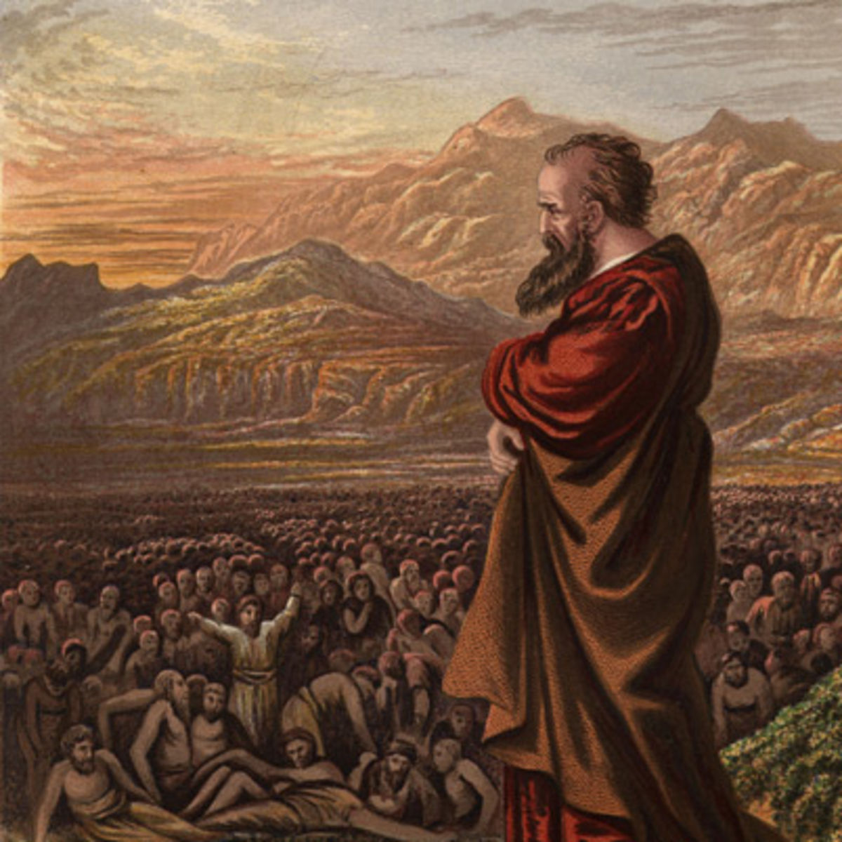
Ezekiel 6-7 Overview
"Son of man, set your face toward the mountains of Israel, and prophesy against them…” (Ezekiel 6:2)
Preaching about disobedience and desolation (6:1-14)
Preaching about chaos and calamity (7:1-27)
“and you will know that I am the LORD.”
(Ezekiel 6:7, 10, 14 and 7:4, 9, 27)

Slide 3
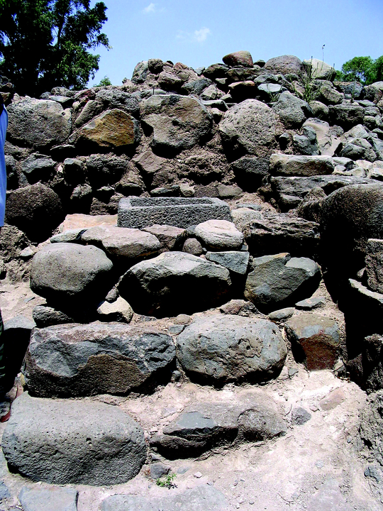
Ezekiel 6
Preaching about disobedience and desolation (6:1-14)
A Dire Prediction (6:1-7)
A Confident Expectation (6:8-10)
A Distressing Lamentation (6:11-14)
“and you will know that I am the LORD.” (Ezekiel 6:7, 10, 14)

Slide 4
Ezekiel 7
Preaching about chaos and calamity (7:1-27)
The Calamity Announced (7:1-9)
Complete and unique judgement.
The Calamity Described (7:10-27)
Social Disruption (7:10-13)
Military Dismay (7:14-18)
Economic Distress (7:19-22)
Political Disorder (7:23-27)
“and you will know that I am the LORD.” (Ezekiel 7:4, 9, 27)

